Slide 1
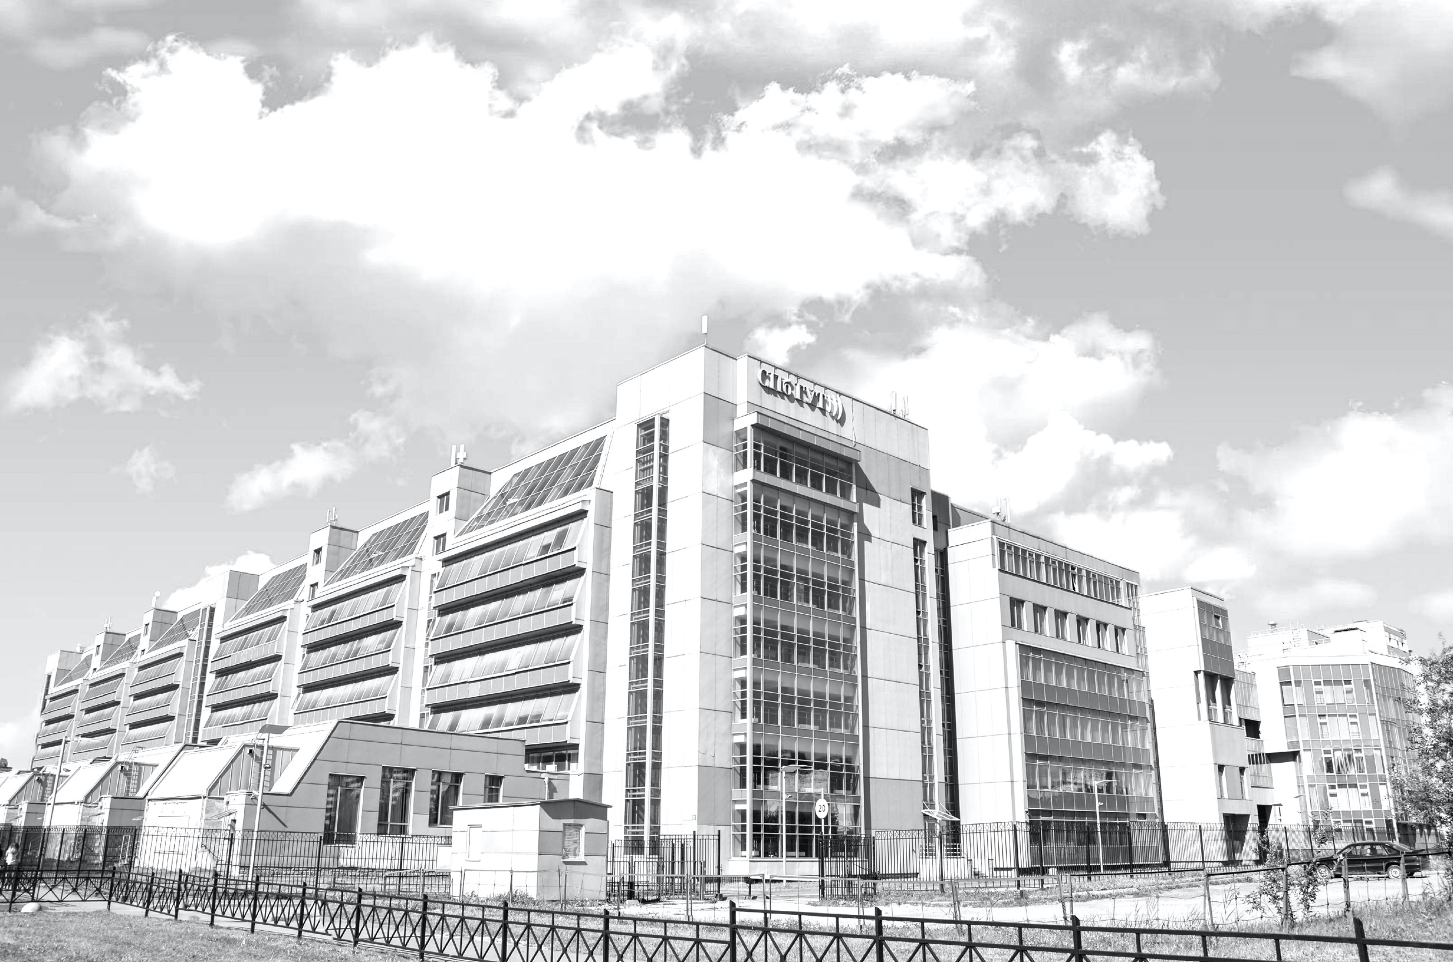
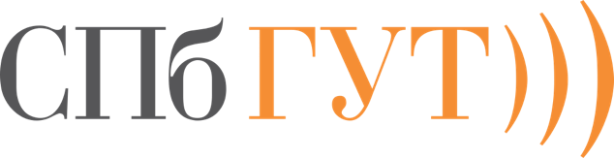
The Bonch-Bruevich Saint-Petersburg State
University of Telecommunications
International Admissions
St. Petersburg

Slide 2
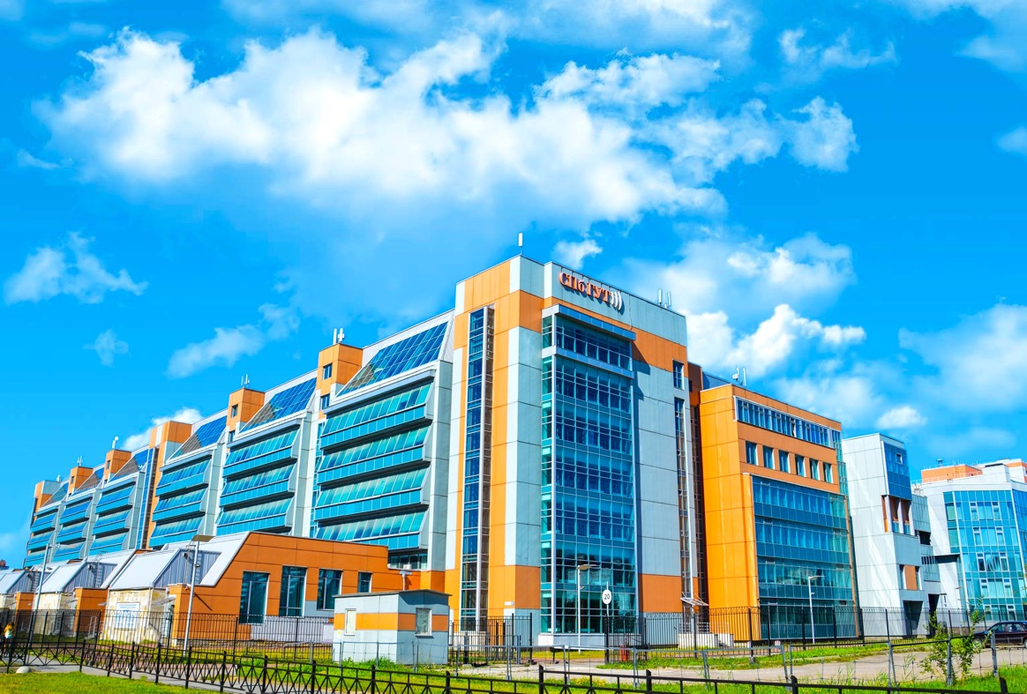
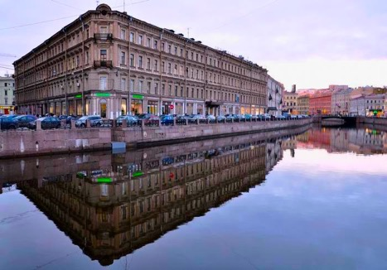
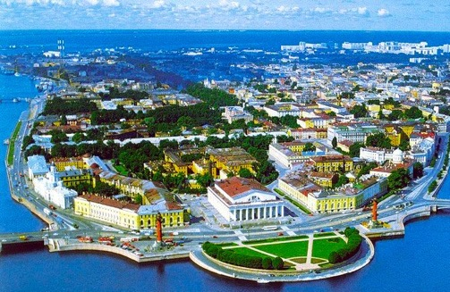
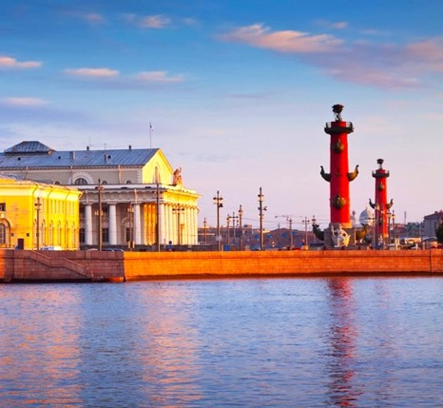
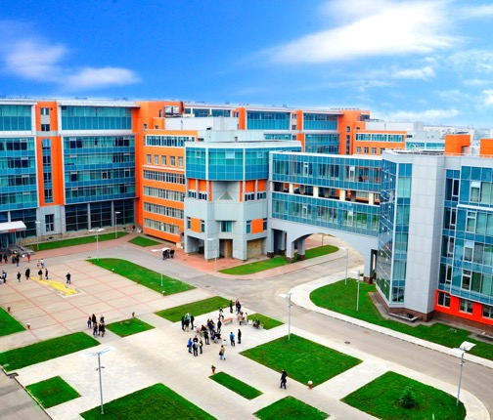
THE BONCH-BRUEVICH ST. PETERSBURG
STATE UNIVERSITY OF TELECOMMUNICATIONS

Slide 3
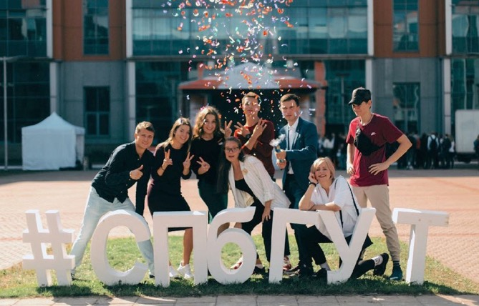
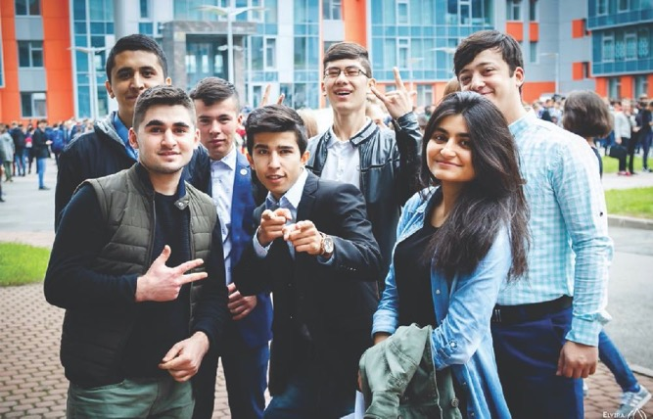
The Bonch-Bruevich St. Petersburg
State University of Telecommunications
State Institution
Many-year experience in the training of highly qualified specialists
1930 – year of foundation
Scientific and educational center
8 research laboratories, scientific conferences, university scientific journal and etc.
Industrial-oriented
640 partnership agreements with industry enterprises
(Huawei, Rostelecom,Tele2 Russia, Gazprom Communication and etc.)
Eventful and fascinating students life
art groups, sport sections, competitons and olympiads, exchange programs etc.
Comfort and safe education area
modern education space, free Wi-Fi, relax areas and cafeteria, medical aid etc.

Slide 4
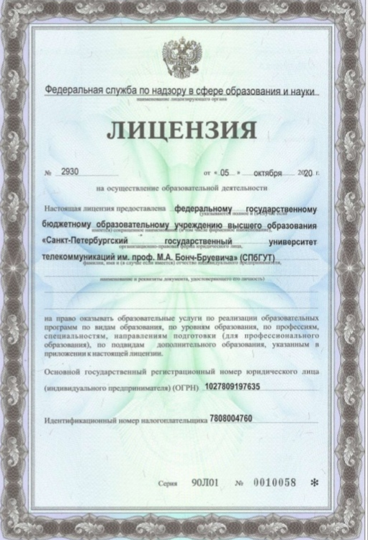
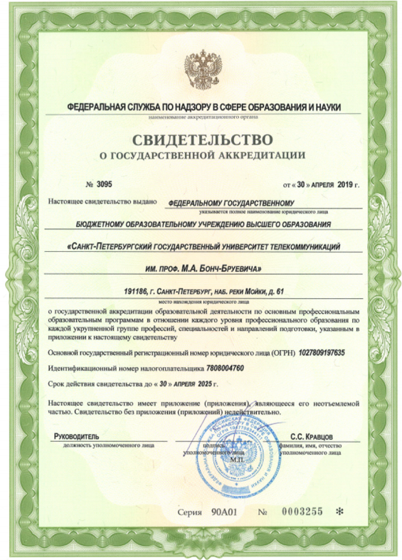
License and Accreditation
The license № 2930 dated by October 5, 2020
(validity period – indefinitely)
The accreditation № 3095 dated by April 30, 2019
(validity period – until April 30, 2025)

Slide 5
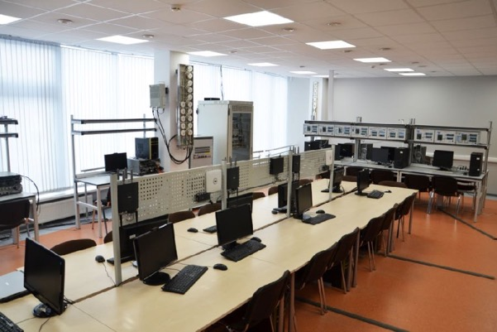
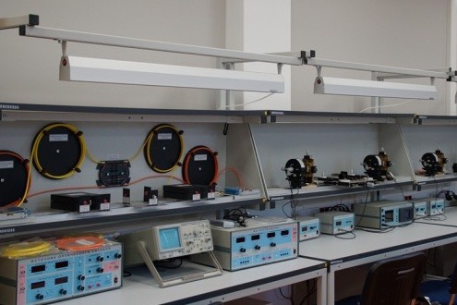
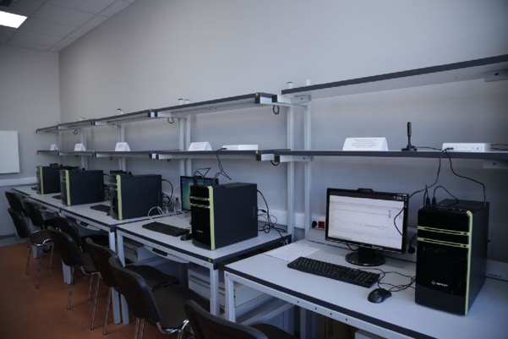
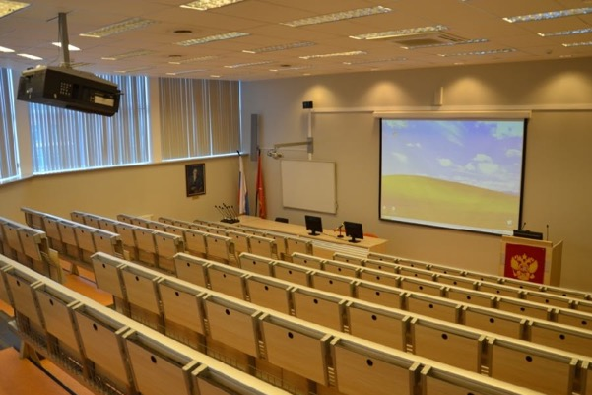
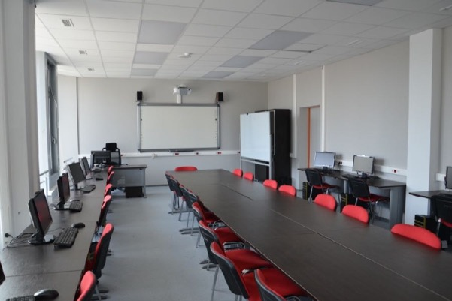
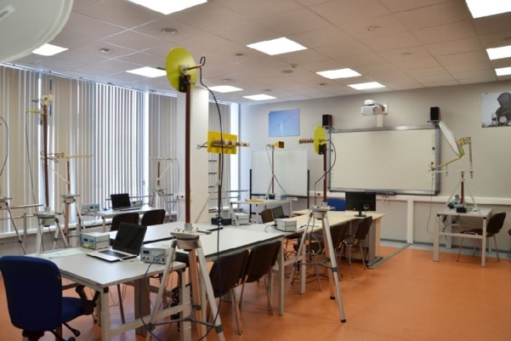
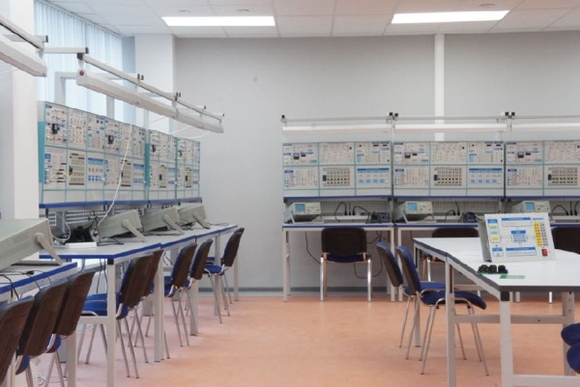
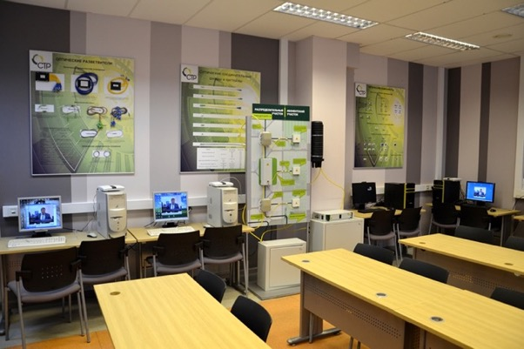
Our laboratories

Slide 6
For what program can I apply?
after School or College
BACHELOR’S DEGREE
after Bachelor’s degree
MASTER’S DEGREE
after Master’s degree
Postgraduate

Slide 7
How many years to study?
BACHELOR’S DEGREE
Full time
4 years
Part-time
5 years
Extramural
5 years
MASTER’S DEGREE
Full time
2 years
Extramural
2,3–2,4 years
Postgraduate
Full time
3 or 4 years
Extramural
5 years

Slide 8
The Faculties
Faculty of Radiotechnologies of Communication
Faculty of Infocommunication Networks and Systems
Faculty of Information Systems and Technologies
Faculty of Fundamental Training
Faculty of Digital Economy, Management and Business Informatics
Faculty of Social Digital Technologies
Institute of Master’s Programs
Faculty of Ongoing Education

Slide 9
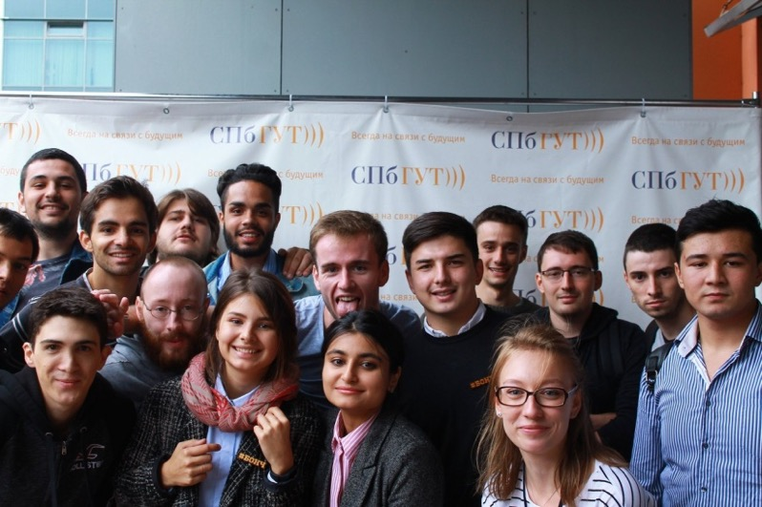
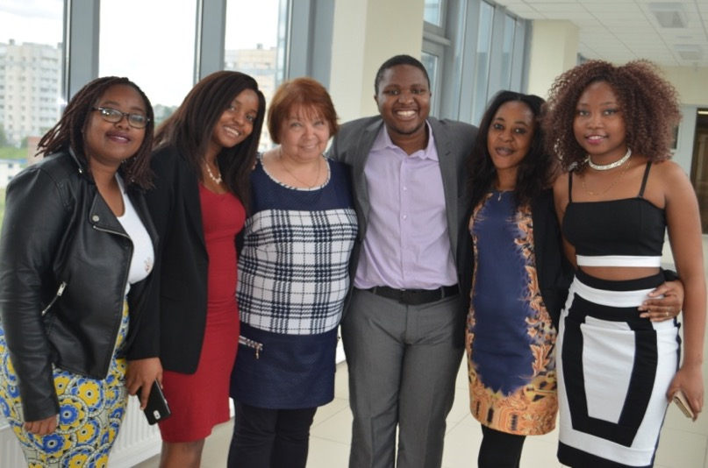
Postgraduate Programs
03.06.01
Physics and Astronomy
09.06.01
Informatics and Computer Science
10.06.01
Information Security
11.06.01
Electronics, Radio Engineering and Communication Systems
38.06.01
Economics

Slide 10
DOCUMENTS FOR ADMISSION
CERTIFY THE IDENTITY
passport
copy and translation into Russian certified by a notary
DEGREE CERTIFICATE
diploma or academic certificate
copy and translation into Russian certified by a notary
2 photos 3 × 4
THE RECOGNITION OF EDUCATION
validation or recognition of foreign studies or degree
not required for some countries, details: www.nic.gov.ru
INDIVIDUAL INSURANCE ACCOUNT NUMBER (SNILS) (if applicable)

Slide 11
Documents at the time of enrollment
(August-September)
HIV certificate
validity period – 3 mounths
If you are in Russia
Migration card with purpose of entry «STUDY»
  Only for students on full or part-time study
  Extramural students can have any purpose of entry
  Belarus Citizens don’t have a migration card
CURRENT REGISTRATION
only for students on full or part-time study

Slide 12
Entrance Examinations
BACHELOR’S DEGREE
3 subjects
Russian language+2 subjects
Unified State Examination (USE) (if applicable)
or
University exams
MASTER’S DEGREE
interview
portfolio contest
(optional)
Postgraduate
Special discipline according to the chosen profile
Philosophy
Foreign language (English)

Slide 13
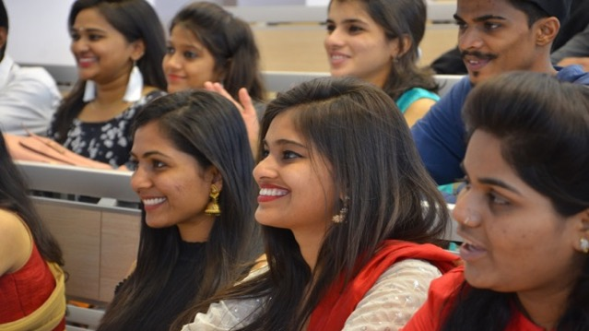
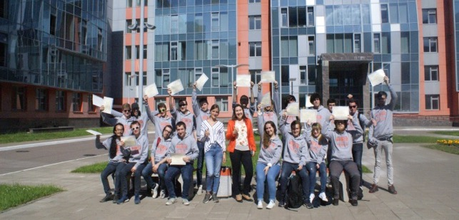
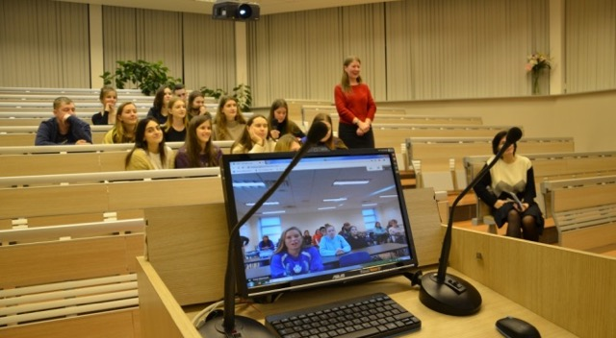
How to Study for Free
Citizens of Belarus, Kazakhstan, Kyrgyzstan, Tajikistan have equal rights as Russians in appliyng to the university (on a competitive basis)
Government Scholarships (quota of the Ministry of Science and Higher Education) https://education-in-russia.com/
According to the Federal Law on compatriots abroad
According to the international treaties between Russia and other countries

Slide 14
Dormitories
«Dalnevostochnoe»
SPb, Dalnevostochnyi av., b. 71
Subway stantion «Ulitsa Dybenko»
15-floors block (corridor) type dormitory
double rooms (298 rooms)
3 100 rub./month
«Rybatskoye»
SPb, st. Karavaevskaiia, b. 34
Subway stantion «Rybatskoye»
16-floors building apartment type dormitory
Apartments 2–3 rooms, rooms for 2–3 people (270 rooms)
3 300 rub./month standard
5 000 рrub./month comfort

Slide 15


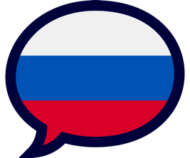
Activities of Foreign Students
Foreign Student Council
Student government of foreign students led by the President of the Council
International Festival of National Cultures
and other cultural events
Russian Speaking Club
and much more!

Slide 16
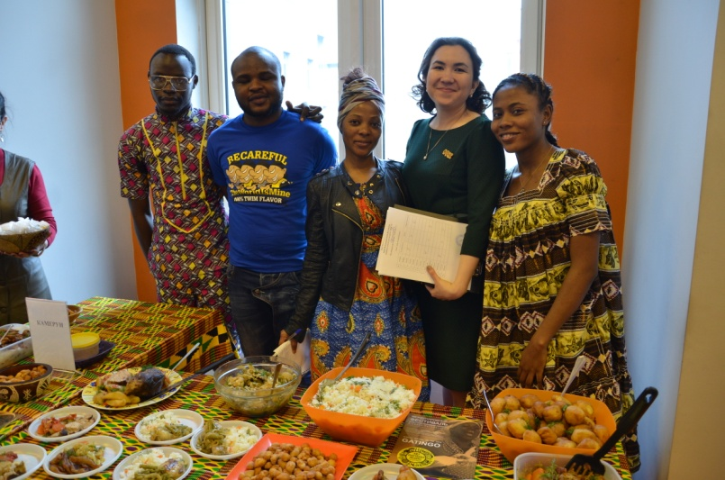
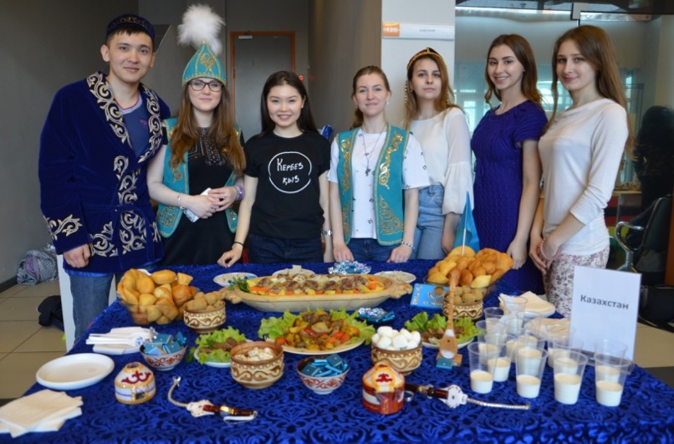
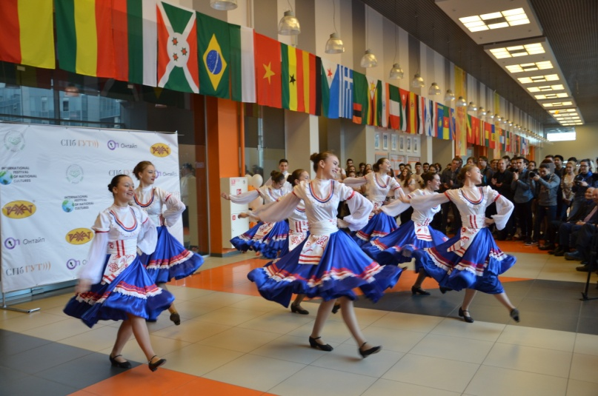
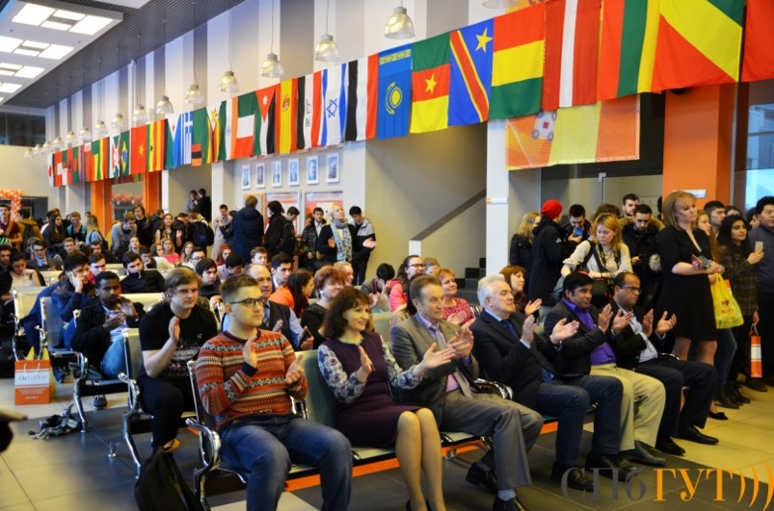
International Festival of National Cultures

Slide 17
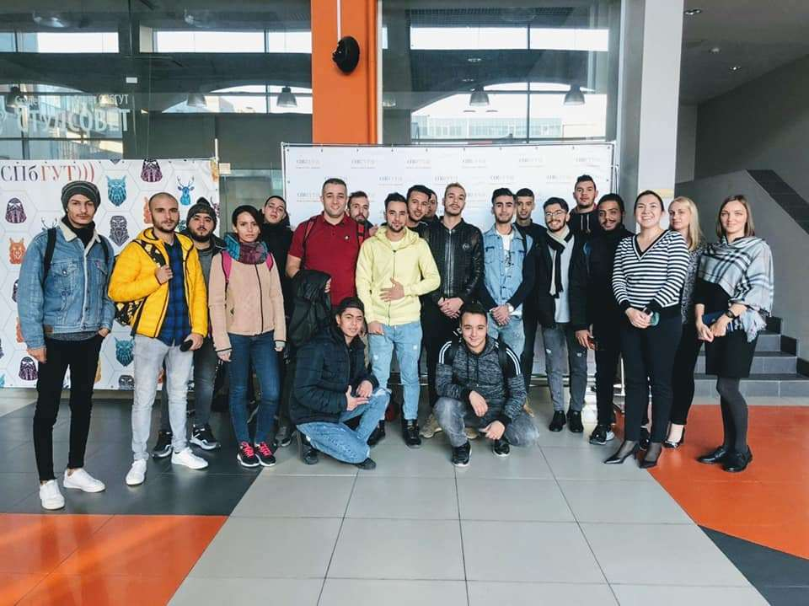
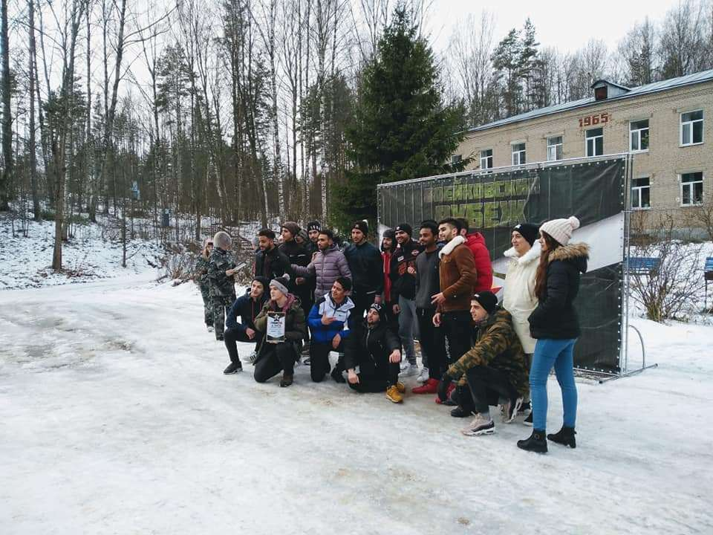
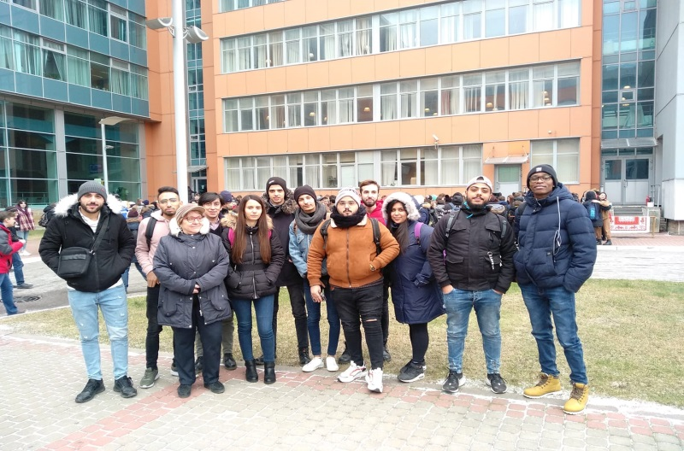
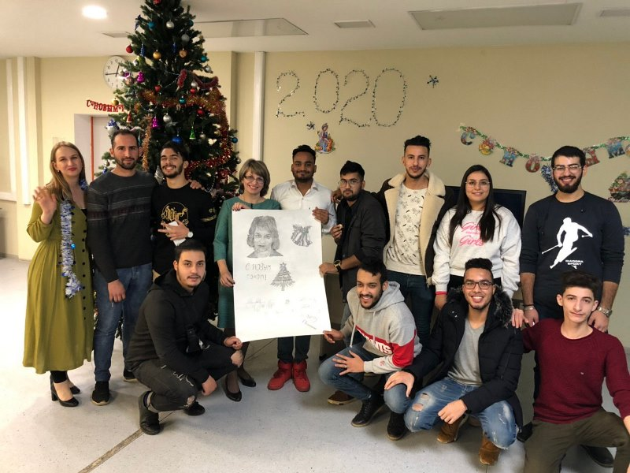
Russian Speaking Club

Slide 18
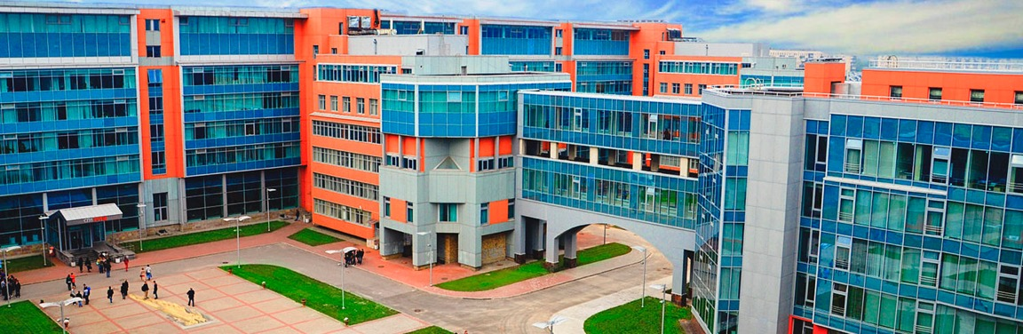


Contacts
22 Prospect Bolshevikov, 193232,
St. Petersburg, Russia
office 345/1
INTERNATIONAL cooperation
Department
PRIEM.SUT.RU
dmo@sut.ru
WWW.SUT.RU
+ 7 (812) 305-12-37

Slide 19
The Bonch-Bruevich Saint-Petersburg State
University of Telecommunications
Admission of International Students
St. Petersburg

